Slide 1
Timeline
DATE | TOPICS | RELATED TOPIC
05/5/2025 – 09/5/2025 | Basic transformations: Negative, Power Law, Log, Piecewise Linear stretching, Thresholding. Histogram analysis: Histogram Equalization, Histogram Matching, Contrast Local Adaptive Histogram Equalization. | Basic transformations & Histogram analysis
12/5/2025 - 16/5/2025 | Correlation and Convolution, Box filter, Gaussian Filter, Median filter. Resize images, Nearest Neighbor Interpolation, Linear Interpolation, Bilinear Interpolation. | Fundamentals of Spatial filtering
19/5/2025 – 21/5/2025 22/5/2025 – 23/5/2025 | Sobel filter: Derivative in detecting edge, Gradient, Sensitivity of derivatives to noise, Sobel Filter Program Bilateral filter: Compare Bilateral Filter and Gaussian Filter, My implementation program | Sobel filter Bilateral filter
26/5/2025 – 28/5/2025 29/5/2025 – 30/5/2025 | Canny edge detecting: Gradient, Non-Maximum Suppression, Hysteresis threshold, My implementation program Morphological Image Processing: Dilation, Erosion, Opening, Closing | Canny edge detecting, Morphological Image Processing
02/6/2025 – 04/6/2025 04/6/2025 – 06/06/2025 | Morphological Image Processing: Hit or miss transform, Boundary Extraction, Thinning, Skeleton. Thresholding | Morphological Image Processing Thresholding
09/6/2025 – 11/6/2025 12/6/2025 – 13/06/2025 | Template Matching Hough Transform: HoughLines, HoughCircle | Template Matching Hough Transform

Slide 2
Timeline
DATE | TOPICS | RELATED TOPIC
16/6/2025 – 20/6/2025 | Geometric Transfrom | Geometric Transfrom

Slide 3
GEOMETRIC TRANSFORM

Slide 4
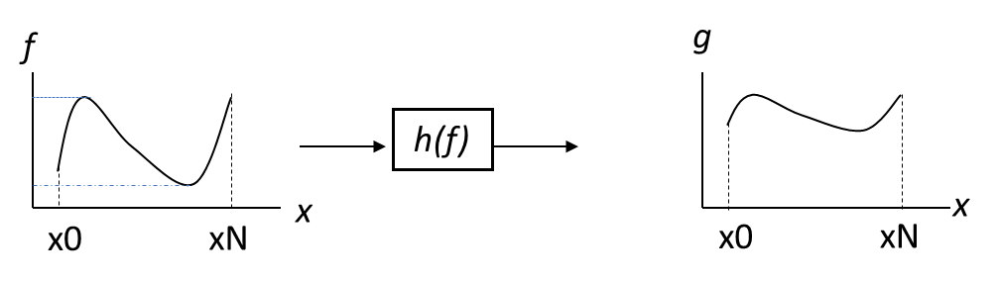
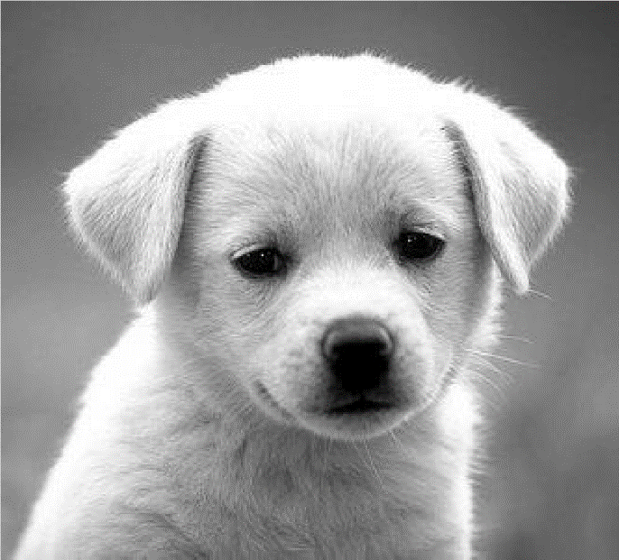

Image filtering
Image filtering: change the intensity range of image by considering its pixel value f(x) or neighboring pixel values to g(x).
g(x) = h(f(x))
h(f)
h(f)
Original Image
Result Image

Slide 5
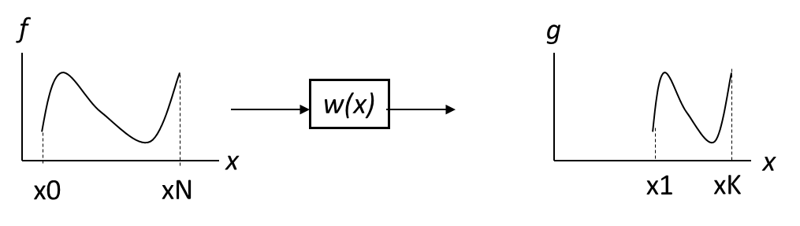
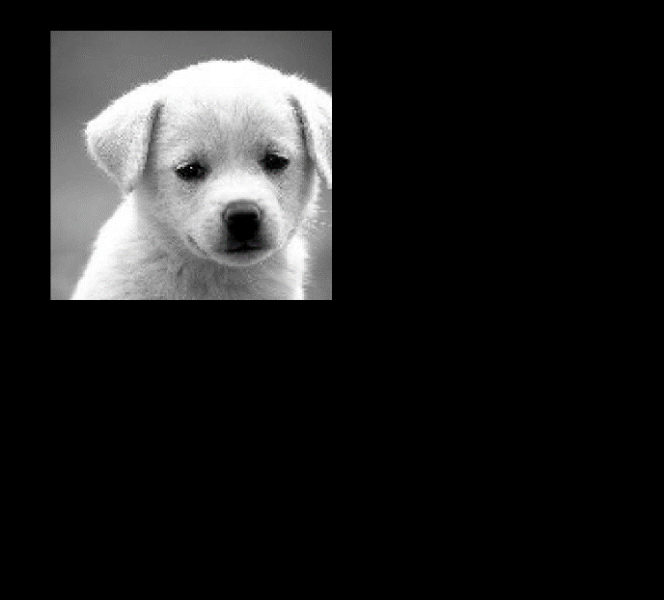
Geometric Mapping
Geometric Mapping : change domain of image coordinate, x by new coordinate w(x) by g(x) = f(w(x)).
g(x, y) = f(w(x, y))
w(x)
w(x, y)
Original Image
Result Image

Slide 6
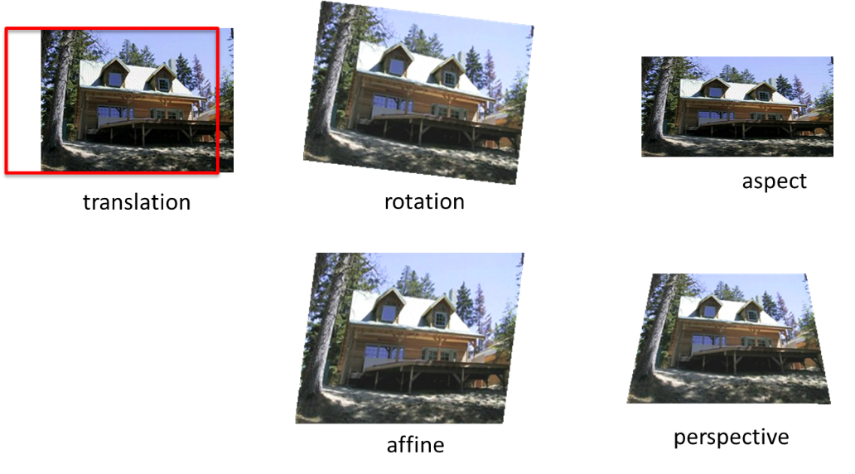
Example of Geometric warping

Slide 7
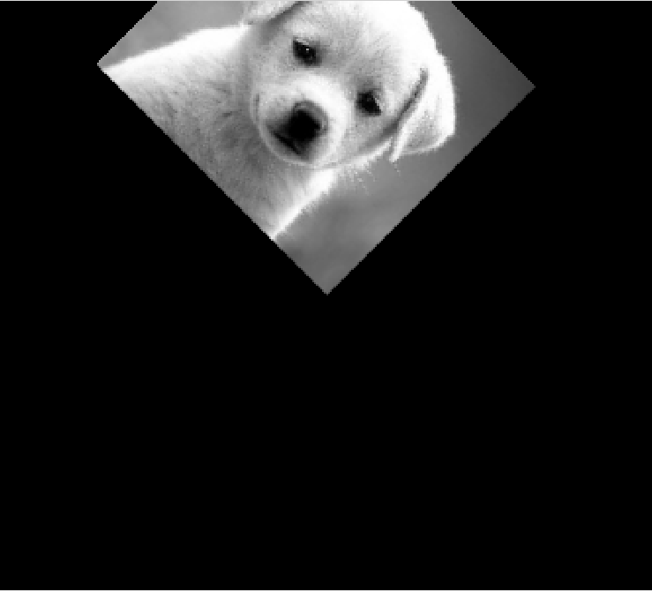
2x2 Linear Transformations
T(x, y)
T can represented by a matrix

Slide 8
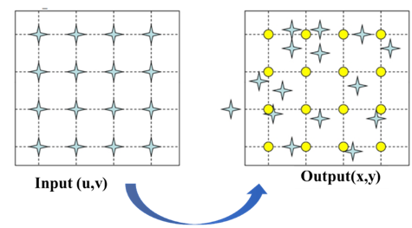
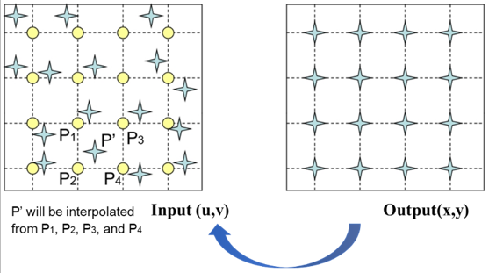
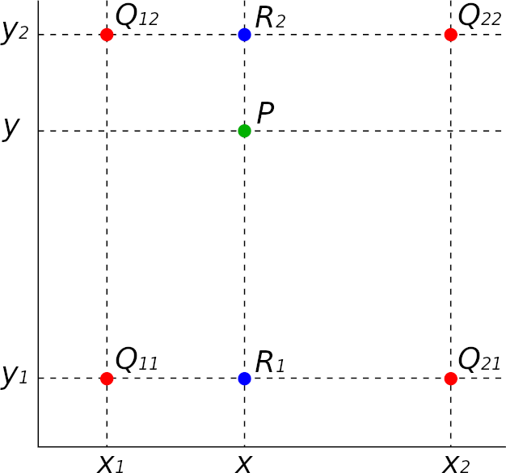

Forward mapping
Inverse mapping
Pixel are missed
T(u, v)
$T^{−1}$(x, y)
Map each source pixel to a new position in the destination image
Map each destination pixel back to the corresponding point in source
(x, y) often non-integer → Rounding to nearest pixel
(u, v) often non-integer → Need Interpolation in original image
Bilinear Interpolation
R₁(x, y) = Q₁₁ · (x₂ – x) / (x₂ – x₁) + Q₂₁ · (x – x₁) / (x₂ – x₁)
R₂(x, y) = Q₁₂ · (x₂ – x) / (x₂ – x₁) + Q₂₂ · (x – x₁) / (x₂ – x₁)
P(x, y) = R₁ · (y₂ – y) / (y₂ – y₁) + R₂ · (y – y₁) / (y₂ – y₁)
May leave holes in destination image - Some pixels are missed
More complete and higher-quality result

Slide 9

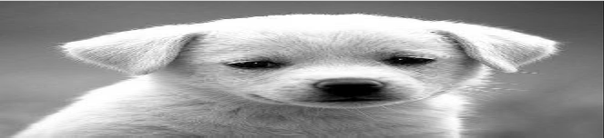
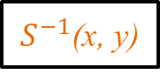
Scaling (Stretching or Squishing)
S(u, v)
$S^{−1}$(x, y)
Forward:
Inverse:

Slide 10
Rotation
Notes:
Polar coordinate system

Slide 11
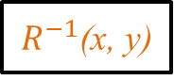
Rotation
R(u, v)
$R^{−1}$(x, y)
Forward:
Inverse:

Slide 12

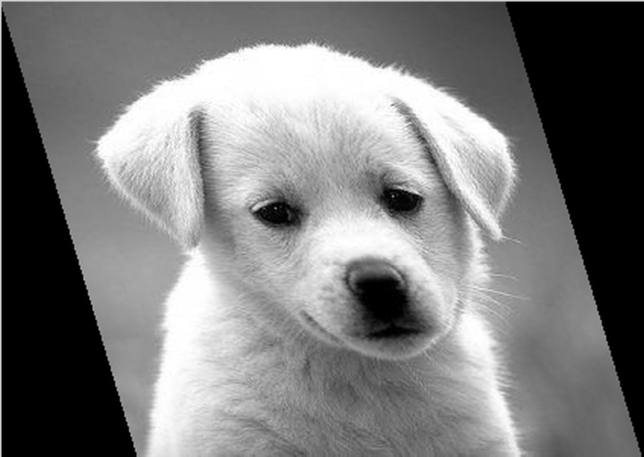
Skewing
Original Image
Horizontal Skew
Vertical Skew

Slide 13
2x2 Linear Transformations
Any transformation of the form:
Origin maps to the origin
Lines map to lines
Parallel lines remain parallel
Closed under composition

Slide 14
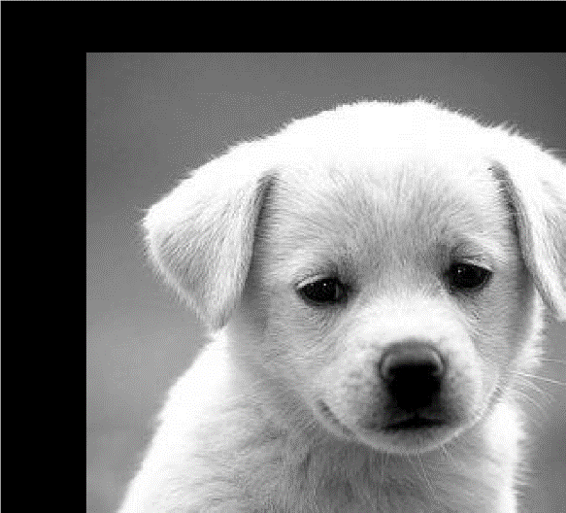
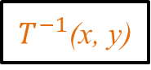
Translation
T(u, v)
$T^{−1}$(x, y)
Forward:
Inverse:
Problem: Translation can’t be expressed as 2x2 matrix
Notes:
Now, consider the seemingly simple problem of translating (shifting) an image. Given the image on the left, we want to translate it by tx in the x-direction and ty in the y-direction. This can be represented by the two simple expressions shown here. However, there is no way to represent these expressions as a 2x2 transformation matrix. We will address this problem by using homogeneous coordinates.

Slide 15
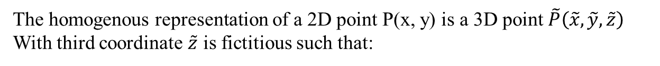

Homogenous Coordinates
The homogenous representation of a 2D point P(x, y) is a 3D point $\tilde{P}\left(\tilde{x}, \tilde{y}, \tilde{z}\right)$
With third coordinate $\tilde{z}$ is fictitious such that:
Find P from $\tilde{P}$:
(With $\tilde{z}$ $≠0)$
In 3D coordinates system:
Notes:
used to normalize the first two coordinates Let’s examine this concept from a geometric
perspective.

Slide 16
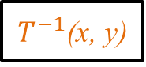
Translation
T(u, v)
$T^{−1}$(x, y)
Forward:
Inverse:

Slide 17
Scaling, Rotation
Scaling
Skewing
Forward
Inverse
Skew along the X-axis
Skew along the Y-axis
Rotation
Forward
Inverse

Slide 18
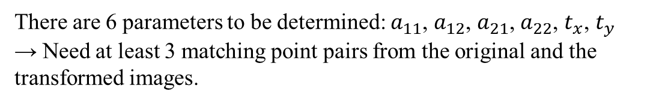
Affine Transform
Affine transformation is a linear composite operation, as it merges all linear geometric transformations (such as rotation, scaling, shear, and reflection) along with translation into a single matrix operation.
Rotation, Scaling, Skewing
component
Translation
component
There are 6 parameters to be determined: $a_{11}$, $a_{12}$, $a_{21}$, $a_{22}$, $t_{x}$, $t_{y}$ → Need at least 3 matching point pairs from the original and the transformed images.
Notes:
The parallel lines remain parallel

Slide 19
Affine Transform
Any transformation of the form:
Origin does not necessarily map to the origin
Lines map to lines
Parallel lines remain parallel
Closed under composition
Notes:
retricted

Slide 20
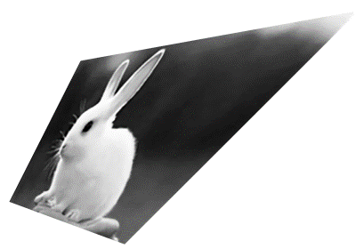
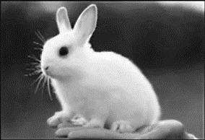
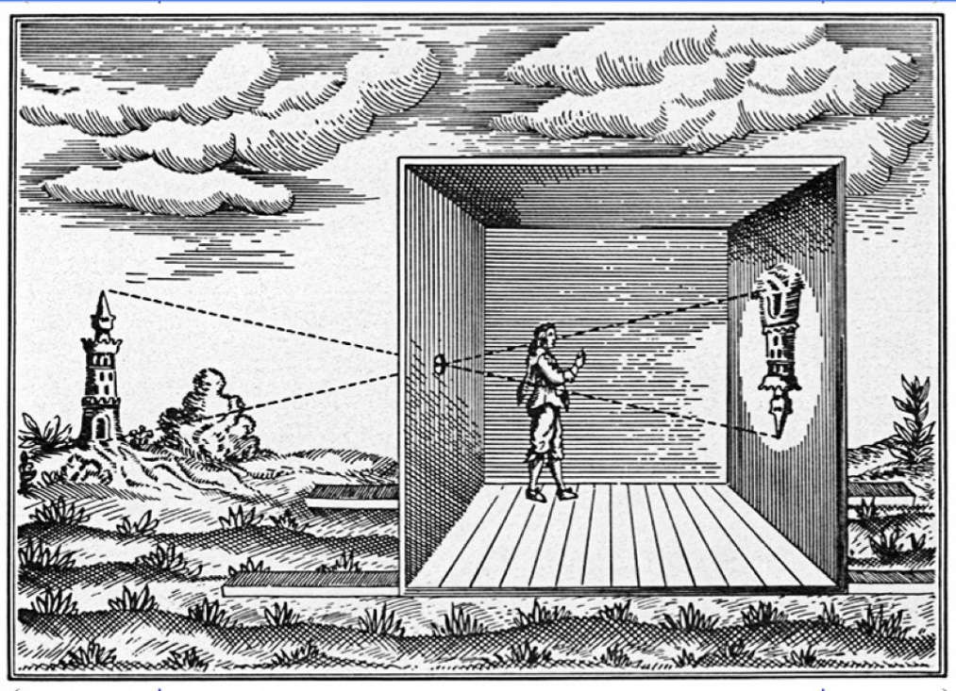
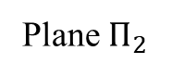
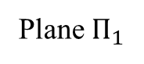
Perspective Transform
Homography matrix
Plane $Π_{1}$
Point
Plane $Π_{2}$
Camera obscura experiment

Slide 21
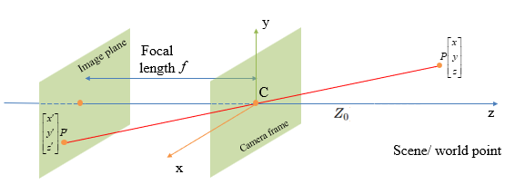
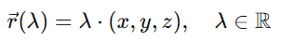
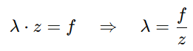
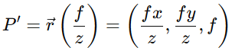
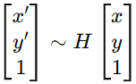
Perspective Transform
The line from P(x, y, z) pass through the origin C(0, 0, 0) have equation:
To find the image point P', we intersect this line with the image plane z′ = f
Homogeneous coordinates form:
Projection matrix
Or:

Slide 22
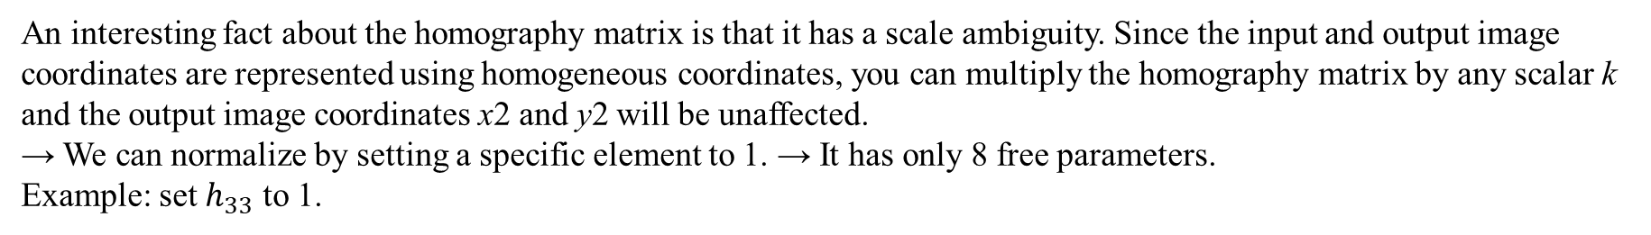
Perspective Transform
An interesting fact about the homography matrix is that it has a scale ambiguity. Since the input and output image coordinates are represented using homogeneous coordinates, you can multiply the homography matrix by any scalar k and the output image coordinates x2 and y2 will be unaffected. → We can normalize by setting a specific element to 1. → It has only 8 free parameters.
Example: set $h_{33}$ to 1.
Notes:
The parallel lines do not necessarily remain parallel

Slide 23
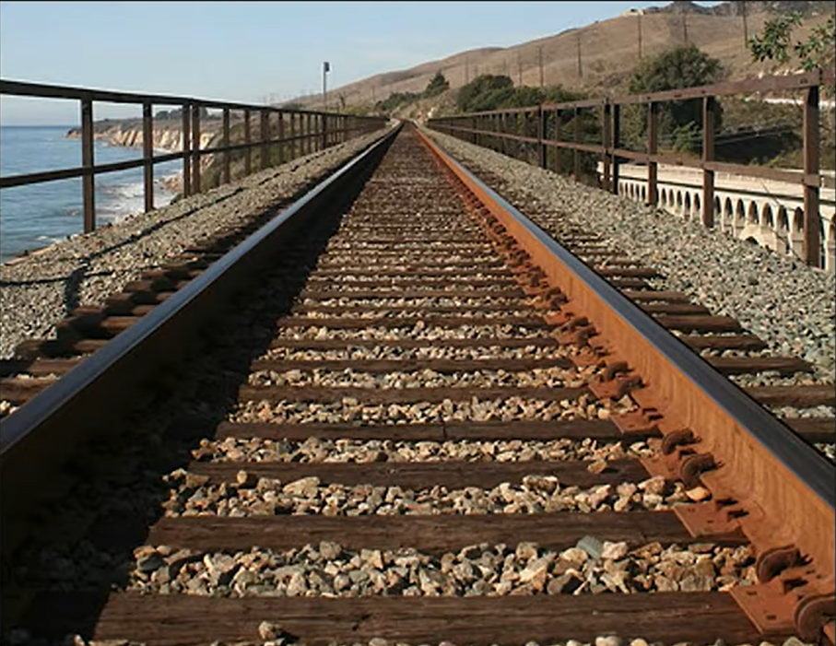
Key Viewpoints of Perspective Transformation
A transformation to illustrate real 3D shape to 2D image plane
Parallel lines (that are not to parallel to the picture plane or not orthogonal to picture plane) converges to a Vanishing Point.
A straight line in 3D is also mapped to a straight line in 2D image.
Notes:
The parallel lines do not necessarily remain parallel

Slide 24
Stitching Image
World
Camera

Slide 25
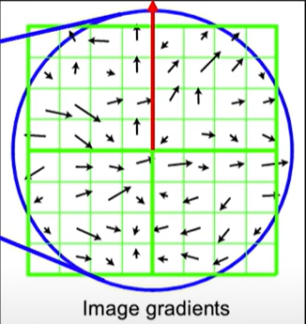
Stitching Image

Slide 26
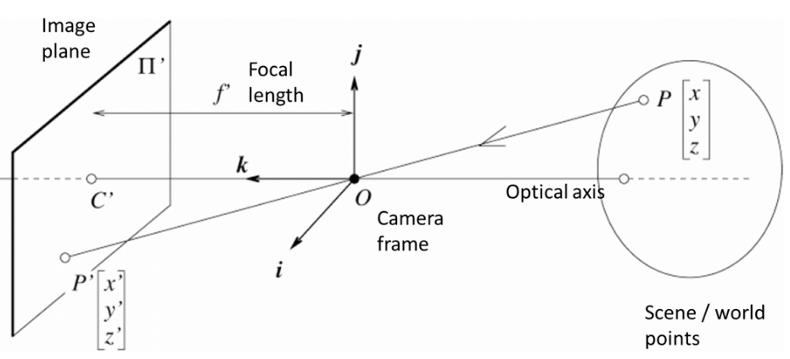

Slide 27
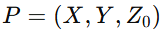
Homogenous Coordinates
y
Image plane
Focal
length
f
C
z
Camera frame
x
Scene/ world point

